Slide 1
Exploratory Data Analysis: NASA Small-Body Databse API
Isabella Westlauer
1/25/2026

Slide 2
Tidy Data – orbit modeling data
Each variable is a column
Each observation is a row
Each cell is a single value
rms | data_arc | spkid | last_obs | n_obs_used
0.43153 | 9520 | 20000001 | 1/28/2021 | 1075
0.35837 | 80789 | 20000002 | 11/5/2025 | 9764
0.35575 | 80649 | 20000003 | 8/8/2025 | 8337
0.40095 | 25743 | 20000004 | 3/17/2021 | 9451
0.47813 | 65687 | 20000005 | 10/19/2025 | 4394
0.41832 | 64646 | 20000006 | 9/3/2025 | 6746
0.35786 | 64712 | 20000007 | 10/26/2025 | 5921
0.54806 | 64929 | 20000008 | 8/3/2025 | 3564
0.43844 | 64348 | 20000009 | 10/4/2025 | 3686
0.47972 | 64419 | 20000010 | 10/9/2025 | 5155
0.3657 | 63979 | 20000011 | 11/17/2025 | 10525
0.51505 | 63981 | 20000012 | 11/20/2025 | 4353
0.50754 | 63731 | 20000013 | 5/18/2025 | 3808
0.52516 | 63559 | 20000014 | 5/26/2025 | 3688
0.43382 | 63619 | 20000015 | 11/7/2025 | 5316
0.17629 | 14782 | 20000016 | 12/11/2024 | 7401
0.34977 | 63408 | 20000017 | 11/24/2025 | 11548
0.44082 | 63226 | 20000018 | 8/7/2025 | 6736
0.33806 | 63236 | 20000019 | 11/2/2025 | 9525
0.32684 | 61738 | 20000020 | 11/10/2025 | 10291
Field Name | Type | Description
rms | number | normalized RMS of the observation fit in the OD
last_obs | string | date of the last observation used in the orbit (YYYY-MM-DD or YYYY-??-?? when only the year is known)
spkid | string | primary SPK-ID
data_arc | number | number of days spanned by the observations used in the orbit determination
n_obs_used | number | total number of observations of all types used in the orbit

Slide 3
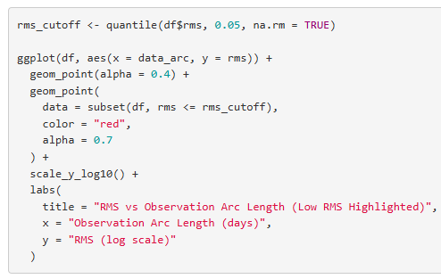
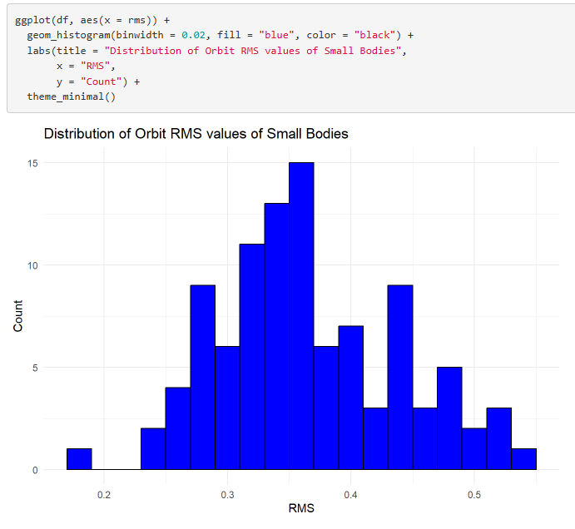
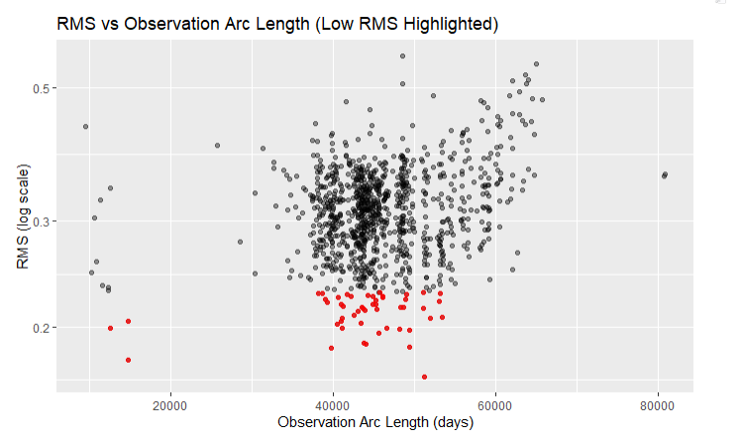
Distribution of Orbit RMS
Red → low uncertainty in orbit model

Slide 4
#Full code here:
https://github.com/Iwestlauer/doing_data_science/blob/main/Unit%204%20Tidyverse/Web_Scraping.Rmd
#NASA API Exploratory Data Analysis
library(httr2) # r library for making http requests to an API
library(tidyverse) # tidyverse includes tibble, dplyr, ggplot2, tidyr, readr, stringr, etc.
# Make an API GET request to sbdb_query.api
fields <- "rms,data_arc,spkid,last_obs,n_obs_used"
limit <- 1000 # limit the number of records returned
resp <- request("https://ssd-api.jpl.nasa.gov/sbdb_query.api") |>
req_url_query(
fields = fields,
limit = limit) |>
# Prevent the request from stopping execution on HTTP errors
req_error(is_error = function(resp) FALSE) |>
req_perform()
# Tidy the data
data <- resp_body_json(resp) # Parse the JSON response into an R list
# The API returns the data as a list of rows (one list per object).
# do.call(rbind, ...) binds all rows together into a single matrix-like object.
# This is necessary to convert the nested JSON structure into rectangular data.
df <- as_tibble(
do.call(rbind, data$data),
.name_repair = "minimal"
)
colnames(df) <- data$fields # Assign column names using the metadata returned by the API
# Some columns are stored as lists due to missing values in the API response.
# unlist() flattens each column into a standard atomic vector,
df <- df |>
mutate(
spkid = unlist(spkid),
rms = unlist(rms),
last_obs = unlist(last_obs),
data_arc = unlist(data_arc),
n_obs_used = unlist(n_obs_used)
)
# Convert columns to appropriate data types:
# Missing Data: Empty strings in last_obs are replaced with NA before conversion
df <- df |>
mutate(
spkid = as.character(spkid),
rms = as.numeric(rms),
n_obs_used = as.numeric(n_obs_used),
data_arc = as.numeric(data_arc),
last_obs = na_if(last_obs, ""),
last_obs = as.Date(last_obs, format = "%Y-%m-%d")
)
## Plot Distribution of Orbit RMS
ggplot(df, aes(x = rms)) +
geom_histogram(binwidth = 0.02, fill = "blue", color = "black") +
labs(title = "Distribution of Orbit RMS values of Small Bodies",
x = "RMS",
y = "Count") +
theme_minimal()
## Plot observation arc length vs RMS
rms_cutoff <- quantile(df$rms, 0.05, na.rm = TRUE)
ggplot(df, aes(x = data_arc, y = rms)) +
geom_point(alpha = 0.4) +
geom_point(
data = subset(df, rms <= rms_cutoff),
color = "red",
alpha = 0.7
) +
scale_y_log10() +
labs(
title = "RMS vs Observation Arc Length (Low RMS Highlighted)",
x = "Observation Arc Length (days)",
y = "RMS (log scale)"
)

Slide 5
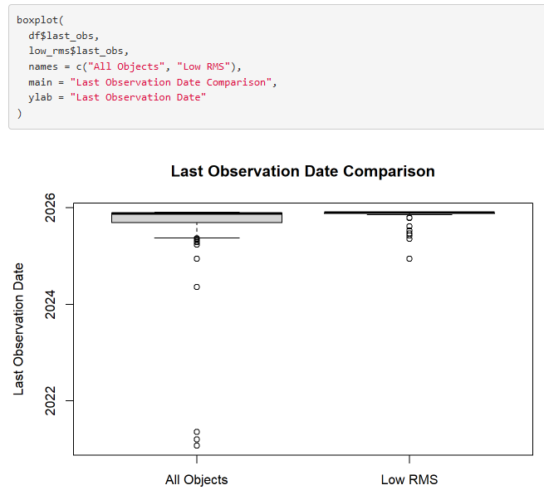
Obstacles
Had to use unlist()
The httr url had fields=field1,field2 which cannot have any spaces between the field names, or you will get a 400 error
If you don’t put a limit on your request and it’s just too much, you will get a 400 error
I couldn’t get usable data from sbdb api, had to use sbdb query api
The date field from the json was a string, but I had to convert it to a date
Tried a boxplot but didn’t know how to interpret it

